Slide 1
ORDERS
BOM
PURCHASE
WAREHOUSE
PLANNING
WAREHOUSE
SHIPMENT
END TO END TESTING

Slide 2
The Process flow of creating a sales order
Adidas Team Order Process
The Adidas team places orders with our organization on a monthly basis, and modifications to these orders are made weekly as needed.
Orders are submitted in a structured format that includes:
PO , CRD , ARTICLE , ORDER QUANTITY
Start
Orders From Adidas
Sales Order Creation Process
The Order Team is responsible for managing customer orders received through the Infonet system. The process involves downloading the orders and creating or updating sales orders in the SAP system
Download Order from Infonet
Create Sales Order
VA01
Standard SAP transaction code used to create new sales orders.
ZSD001N
VA01
VA02
Standard SAP transaction code used to modify or update existing sales orders.
Update
VA02
ZSD001N
A customized transaction code developed to facilitate bulk order uploads efficiently.
Clarification on the Use of VA01 Despite the Availability of ZSD001N ( Earlier-discussed )
While ZSD001N improves efficiency for bulk uploads, VA01 remains essential in scenarios where:
Manual intervention or case-by-case entry is needed.
Quick correction or validation is required before order confirmation.
Orders are not suitable for the bulk upload format.
End

Slide 3
The Process For Pull BOM Data
Process for Pulling BOM Data Using T-code ZMM123
The ZMM123 transaction code is a custom SAP T-code used to pull Bill of Materials (BOM) data for material planning and execution processes.
Start
Access SAP GUI
Log into the SAP system with the appropriate credentials.
Access SAP GUI
Navigate to T-Code ZMM123
In the command field enter ZMM123 and Press Enter.
Navigate to T-code ZMM123
Input Required Parameters
Material Number – Enter the specific material or article number.
Plant Code – Specify the plant for which the BOM data is required.
Other Filters (if applicable) – CRD date, PO number, or other specific criteria to narrow down results
Input Required Parameters
Execute the T-code
Execute the T-code
Click on Execute (F8) to run the process
Review the BOM Data
ZSD001N
The system retrieves and displays the list of BOM components associated with the entered material.
End

Slide 4
The Process of Create Collection and Run
ZMM018 – Create Collection
Purpose:
Used to create a material collection based on BOM data for further planning or allocation.
Go to T-code ZMM018.
Enter the required input parameters, such as:
Material Number / Article
Plant
PO Number
CRD Date
Select the BOM components to include in the collection.
Click "Execute" (F8) or "Create Collection".
A Collection Number will be generated upon successful creation.
ZMM019 – Run Collection
Purpose:
Used to execute the collection to determine material availability, plan material movement, or generate internal requests.
Go to T-code ZMM019.
Enter the Collection Number generated from ZMM018.
Review the collection summary, including:
Required components
Available stock
Shortages (if any)
Click on "Run" or "Execute" to initiate the process.
The system will evaluate material availability and initiate internal processes such as:
Material reservations
Transfer requirements
Notifications to relevant departments

Slide 5
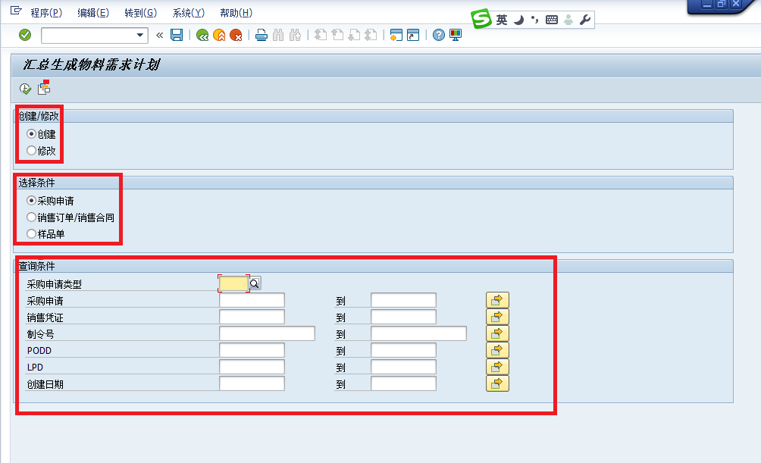
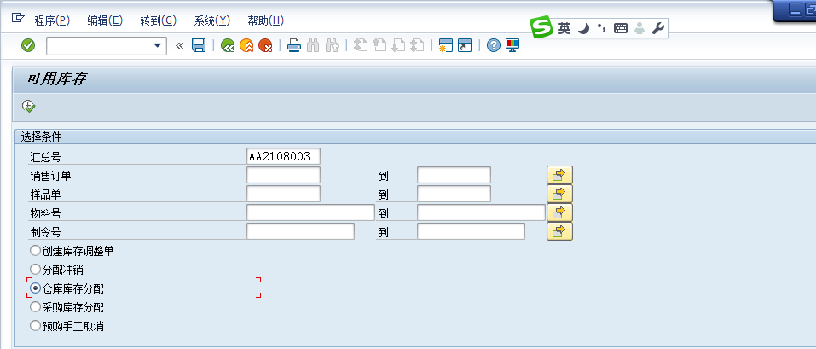
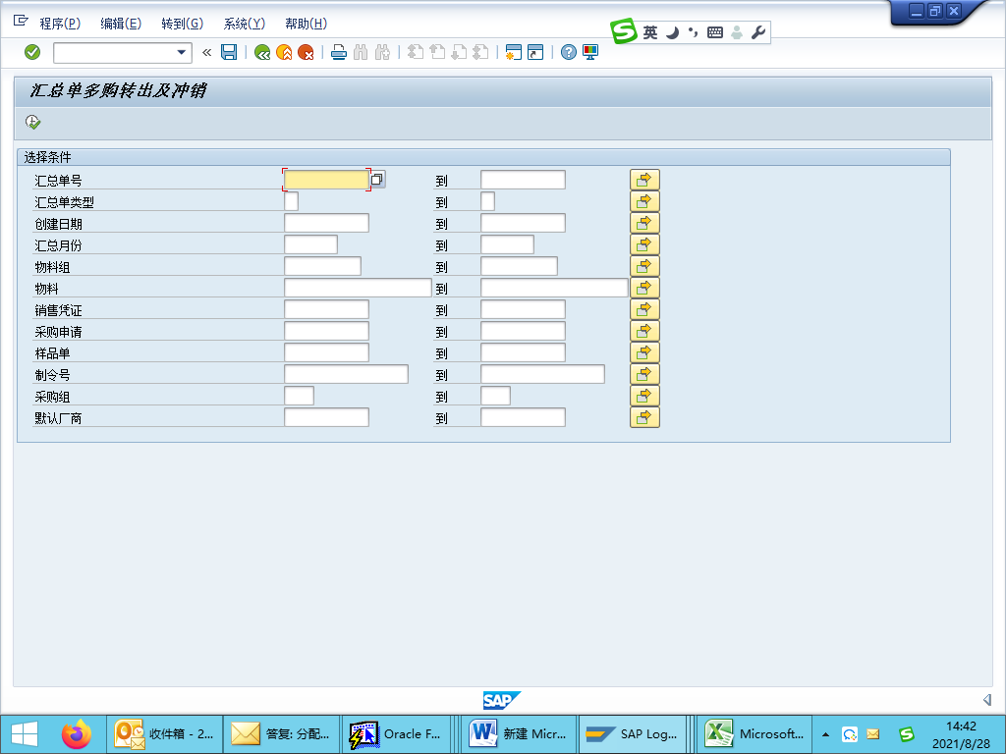
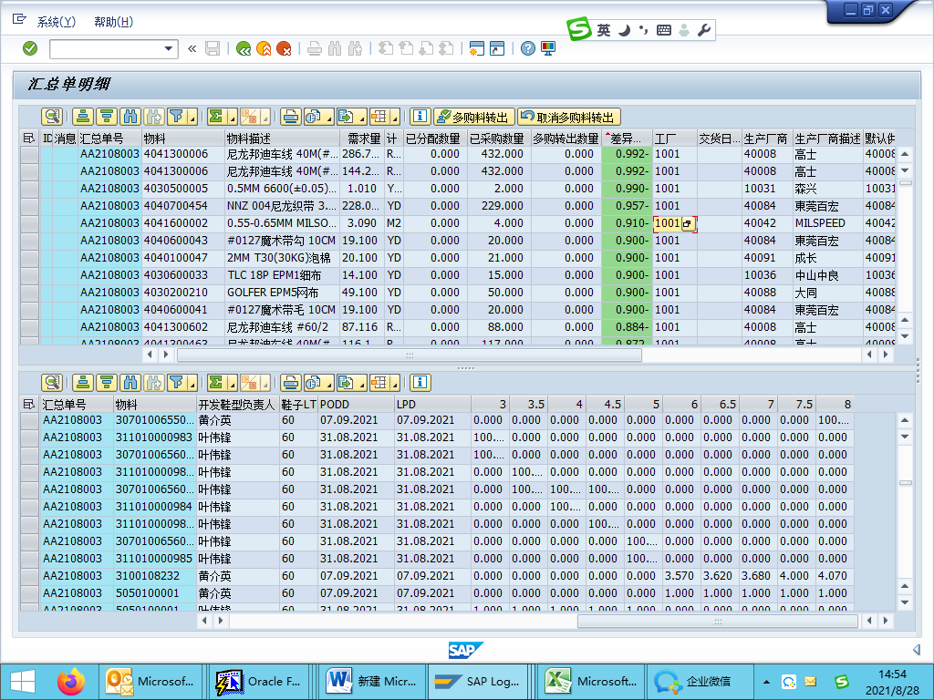
The Process of Create Collection and Run
ZMM019 – Material Order Summary Creation
Select Create Option
Choose the appropriate summary condition based on the order type:
1. Carton Box / Supplement Orders → Select Purchase Requisition
2. Mass Production Orders → Select Sales Order / Sales Contract
3. Development Orders → Select Sample Order
ZMM018 – Material Allocation Process
Warehouse Stock Allocation
Open transaction ZMM018
Enter the Summary Number
Execute
Procurement Stock Allocation
Repeat the same steps as Warehouse Stock Allocation Ensure to save after execution
ZMM017 – Excess Purchase Transfer
Open transaction ZMM017
Enter the Summary Number and Vendor Code
Once the material list appears, review the material status Based on the status :
Transfer for Excess Purchas
Cancel Excess Purchase Transfer

Slide 6
The Process of Create Collection and Run
ZMM019 – Material Order Summary Creation
Select Create Option
Choose the appropriate summary condition based on the order type:
1. Carton Box / Supplement Orders → Select Purchase Requisition
2. Mass Production Orders → Select Sales Order / Sales Contract
3. Development Orders → Select Sample Order

Slide 7
The Process of Create Collection and Run
ZMM018 – Material Allocation Process
Warehouse Stock Allocation
Open transaction ZMM018
Enter the Summary Number
Execute
Procurement Stock Allocation
Repeat the same steps as Warehouse Stock Allocation Ensure to save after execution

Slide 8
The Process of Create Collection and Run
ZMM017 – Excess Purchase Transfer
Open transaction ZMM017
Enter the Summary Number and Vendor Code
Once the material list appears, review the material status Based on the status :
Transfer for Excess Purchas
Cancel Excess Purchase Transfer

